Slide 1

Social media creatives & other graphics works
November

Slide 2
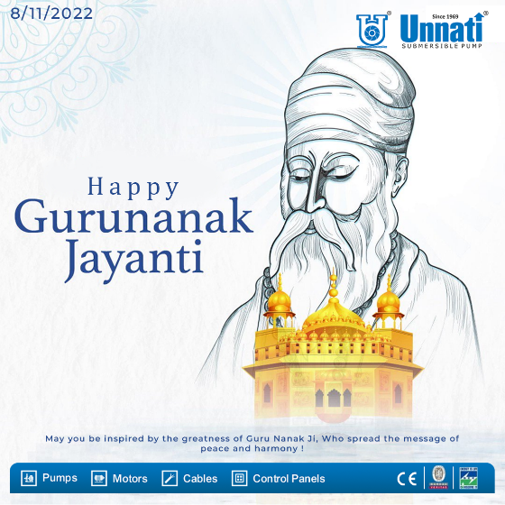
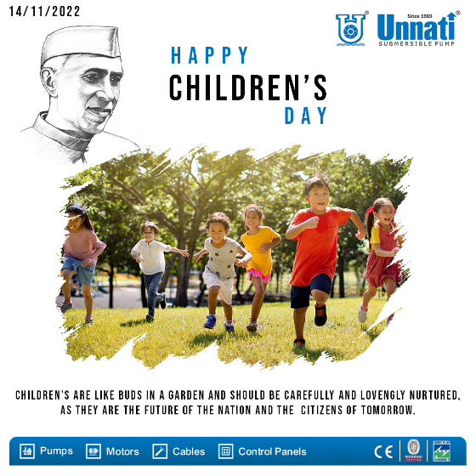
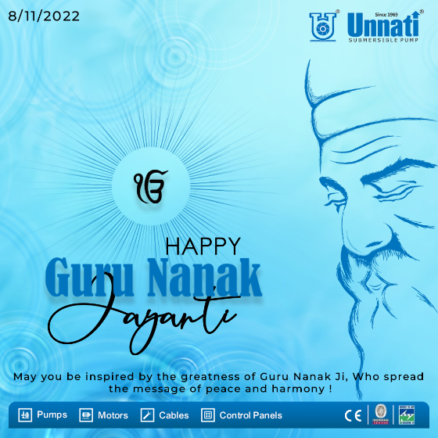
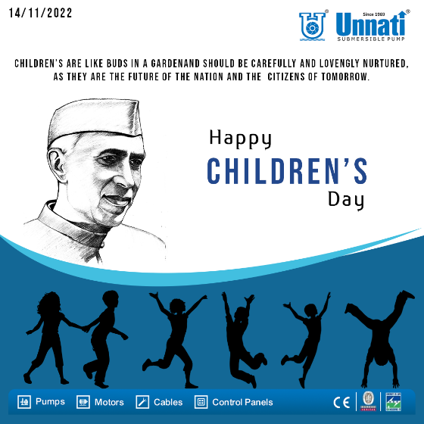
GURU NANAK JAYANTI
CHILDREN DAY

Slide 3
Social media creatives & other graphics works
December

Slide 4


BIS FLYER
INVITATION

Slide 5




AIDS DAY
GEETA JAYANTI

Slide 6
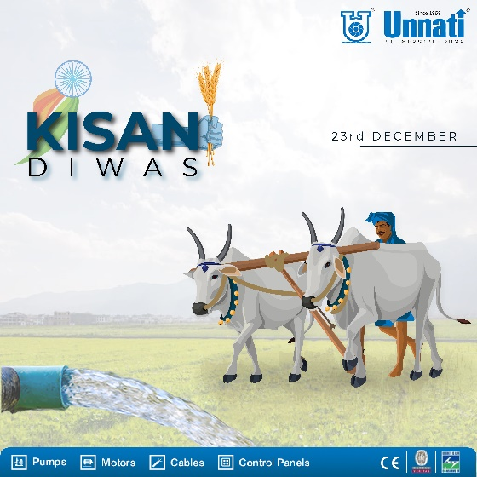



KISAN DIVAS
CHRISTMAS DAY

Slide 7
Social media creatives & other graphics works
January

Slide 8




NEW YEAR DAY
HINDI DIWAS

Slide 9

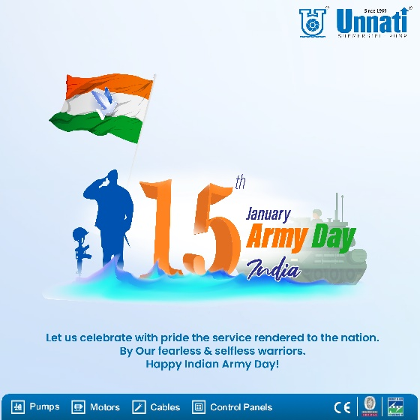

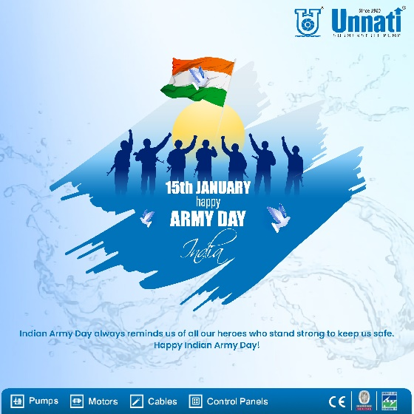
MAKAR SAKRANTI
ARMY DAY

Slide 10

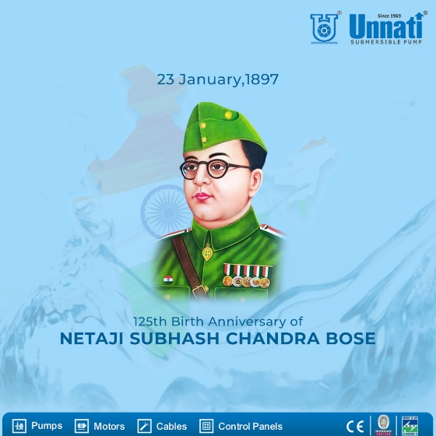

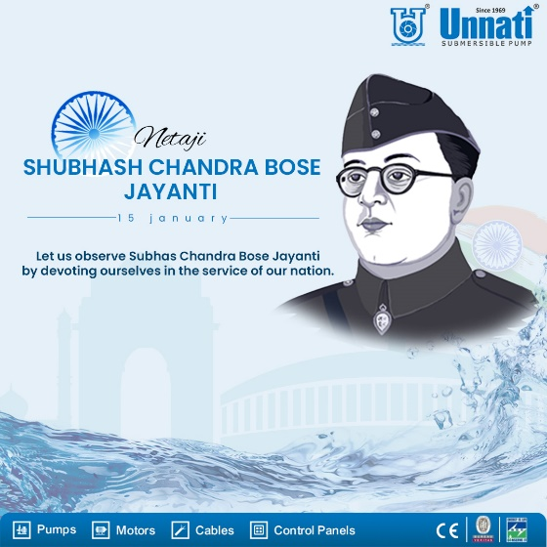
PONGAL
SUBHAS CHANDRA JAYANTI

Slide 11


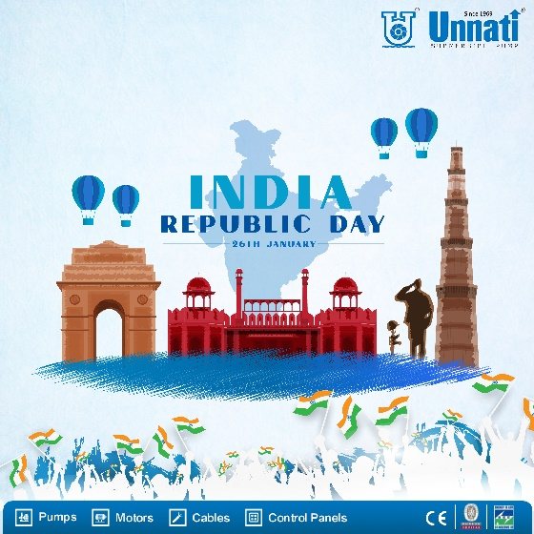
REPUBLIC DAY
INVITATION

Slide 12
Social media creatives & other graphics works
February

Slide 13

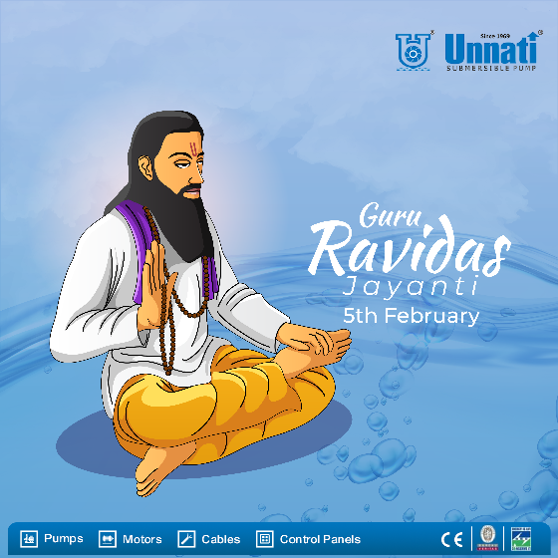

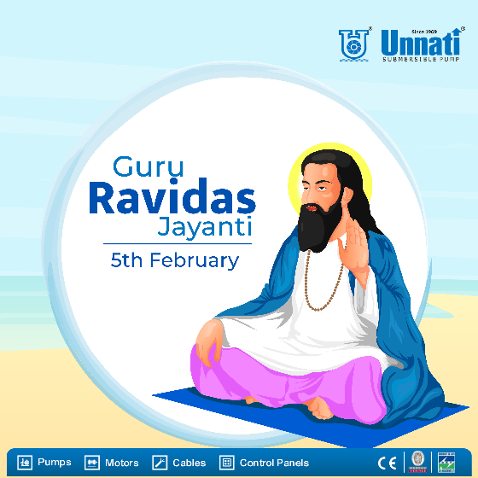
WORLD CANCER DAY
GURU RAVIDAS JAYANTI

Slide 14

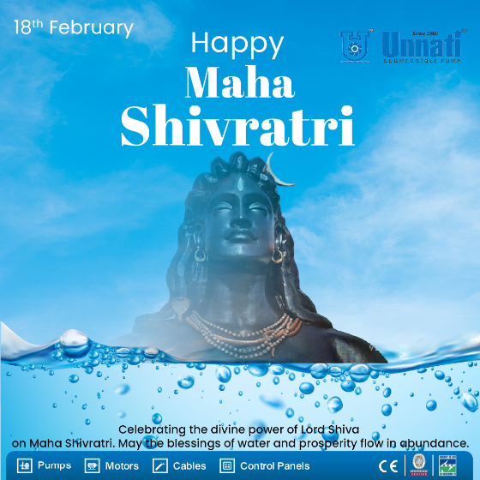


HAZRAT ALI BIRTHDAY
MAHA SHIVRATRI

Slide 15
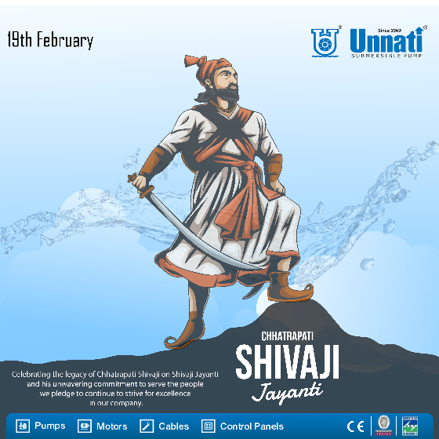

SHIVAJI JAYANTI
TOTAL CREATIVES - 18
INVITATION - 02
FLYER - 01

